Slide 1






Maintenance Request System (Group 1)
Cosme Jan Yvan | Cuadera Paulie Jai | Lorzano Frank | Bautista Chandler V
Engr. Jimlord Quejado
Adviser

Slide 2
INTRODUCTION
School maintenance is important to keep students and staff safe and comfortable (National Center for Education Statistics, 2022; Martins et al., 2021). Many schools still use slow and unreliable methods like verbal or handwritten reports (EdTech Magazine, 2023; TandM Associates, 2024). This causes delays and lost requests.
The School Maintenance Request System is a digital platform that lets users report and track issues easily. It stores data in one place for quick review by maintenance staff. This improves efficiency and stops repeated or forgotten requests.
The system also reduces paper use, supporting eco-friendly practices (Xenia Team, 2023). It helps improve communication and responsibility.
Notes:
If the client is already finalized, remove the word (prospective).

Slide 3
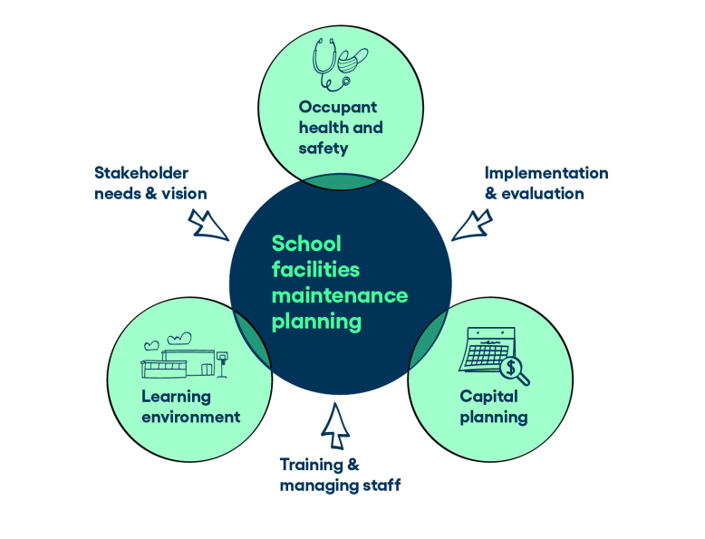
The Problem
Many schools still rely on verbal reporting or handwritten notes to relay maintenance concerns, which often results in delays, lost information, and untracked requests. Because these methods lack proper documentation and organization, important issues are easily overlooked or resolved late. Without a centralized digital system, communication becomes unclear, accountability is limited, and maintenance tasks are difficult to monitor and prioritize, leading to slow responses and inefficient facility management.

Slide 4
Maintenance Request System
Project Objectives
The project aims to:
To create a system that allows school personnel to submit maintenance requests easily and systematically.
To provide a platform where staff can monitor and review pending repair issues for timely resolution.
To ensure that all maintenance data are properly stored and retrievable, improving accountability and record accuracy.

Slide 5
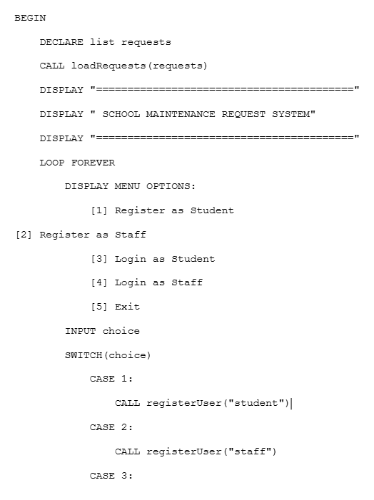
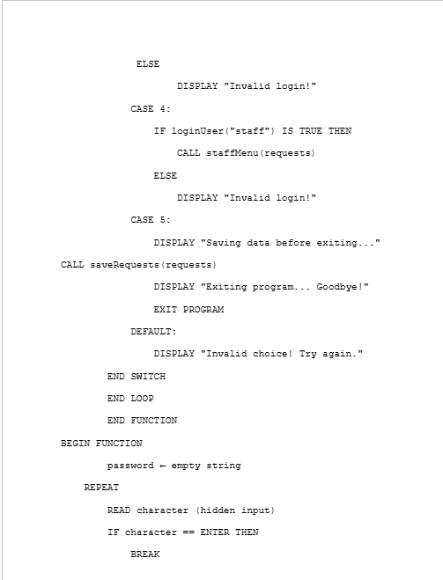
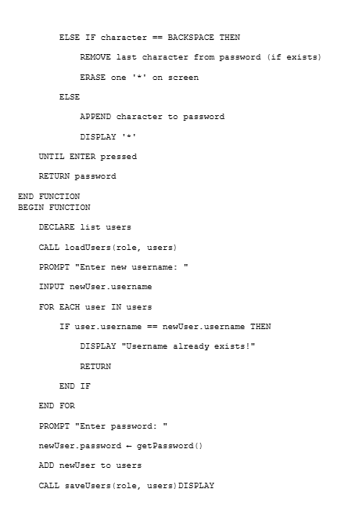
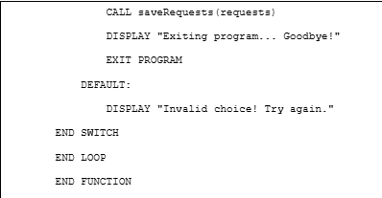
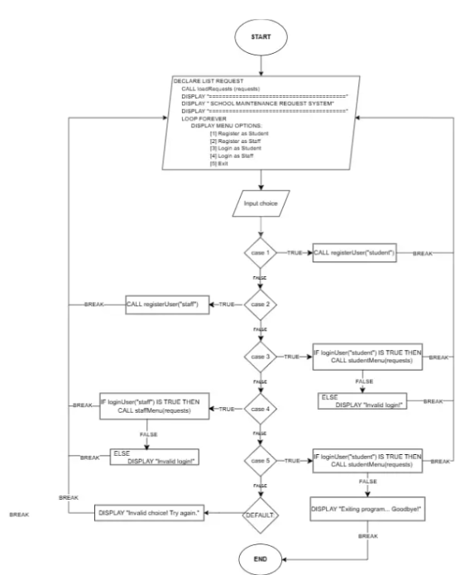
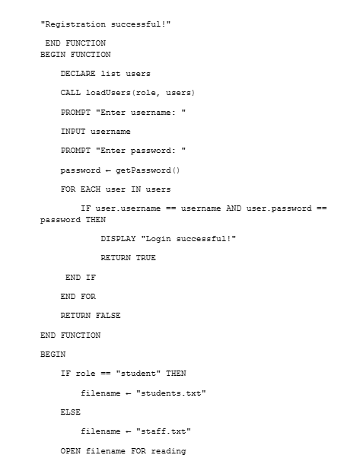
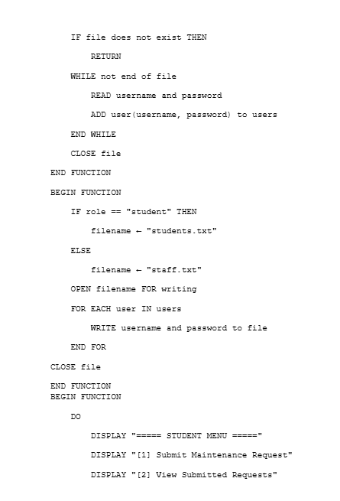
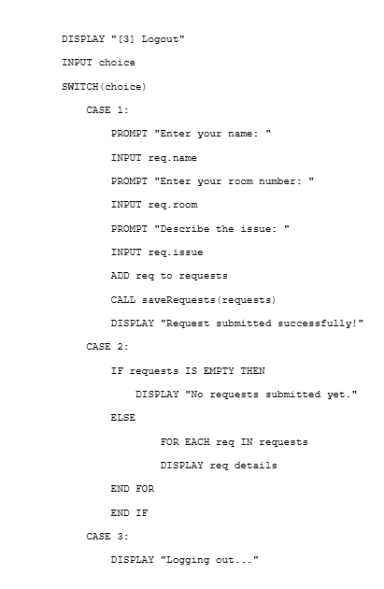
FLOWCHART AND PSEUDOCODE
PSEUDOCODE
FLOW CHART
Notes:
Show pictures of the solutions only, slight text if the product/solution has a name.

Slide 6
REFERENCES
Makmun, S., & Marif, H. (2025). Innovative Approaches in the Management of Educational Facilities: Synergizing Digital Inventory and Preventive Maintenance. Educative: Jurnal Ilmiah Pendidikan, 3(2), 69–76.
publikasi.abidan.org
Martins, P., Lopes, S. I., Rosado da Cruz, A. M., & Curado, A. (2021). Towards a Smart & Sustainable Campus: An Application-Oriented Architecture to Streamline Digitization and Strengthen Sustainability in Academia. Sustainability, 13(6), 3189.
MDPI
Teguh Triwiyanto, Desi Eri Kusumaningrum, Ahmad Yusuf Sobri & Warapark Maitreephun. (2024). Accountability management system of superior elementary school for digital transformation. Journal of Education and Learning (EduLearn), 18(4), 1514-1526.
ERIC
+1
Twana Abdullah Hussein & Ahmet Oztas. (2020). Effect of Using Building Maintenance Information Management System in Maintenance Process in Ministry of Education. Kurdistan Journal of Applied Research.
spu.edu.iq
[Sommer 2024] Sommer, R. Effective facility and grounds maintenance solutions for public schools with CMMS. ClickMaint, 2024.

